Slide 1
Geometry on the Sphere:
Google's S2 Library
Octavian Procopiuc
tavi@google.com
Notes:
about me
ask questions.

Slide 2
Library Overview
C++ library, open source (Apache License 2)
Designed and written by Eric Veach
Basic representations of lat/lng points and 3d vectors
Shapes on the unit sphere:
caps,
lat/lng rectangles,
polygons, polygonal lines.
Hierarchical decomposition of the sphere into "cells".
Ability to approximate regions using cells.
Notes:
Recently open sourced
Widely used inside Google.
I'm mostly a user.
Executive summary: Package for manipulating geometric shapes on the sphere.
Sphere = Earth, but nothing earth-specific.
Talk will focus on last two points.

Slide 3
S2 Cell Hierarchy
Hierarchical division of the sphere.
Goals:
Enough resolution for indexing geographic features
Compact representation of each cell
Fast methods for querying with arbitrary regions
All cells at a given level should have similar area.
One solution: Quad-tree.
Notes:
Resolution: I said nothing Earth-specific, but resolution is chosen with earth in mind.
Compact representation: Want to store cells, use them as keys when indexing.
Fast methods: Cells should have simple shapes.
Similar area: Helps indexing -- balanced tree.
Question: if you were to put a grid over the earth surface with cell size of 1cm, how many bits would you need to represent every cell?

Slide 4
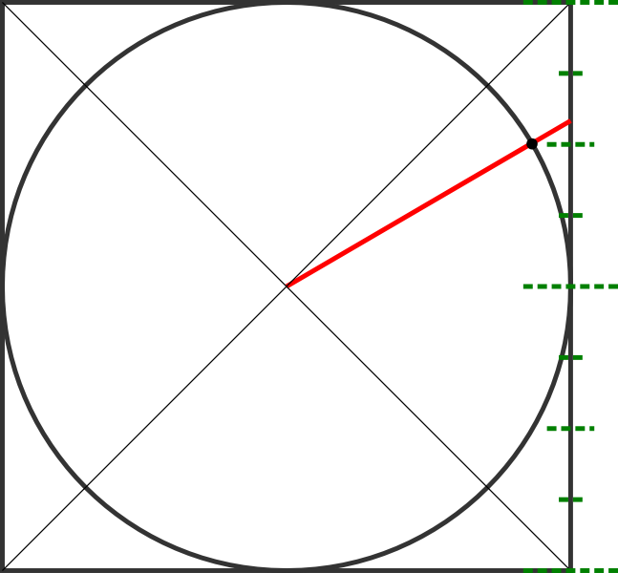
S2 Cell Hierarchy - Construction
Overview:
Enclose sphere in cube [-1,1] x [-1,1] x [-1,1]
Project p on the cube
Build a quad-tree on each cube face
Find quad-tree cell that contains the projection of p
Step 1:
p=(lat,lng) => (x,y,z)
p
Notes:
Pretend this is a sphere inside a cube (couldn't draw a sphere).
Sphere center is origin. Radius is 1.
Basic idea is simple: project p etc.
The green guides are my idea of a quad-tree representation.
First trivial step: create a 3-d vector.

Slide 5
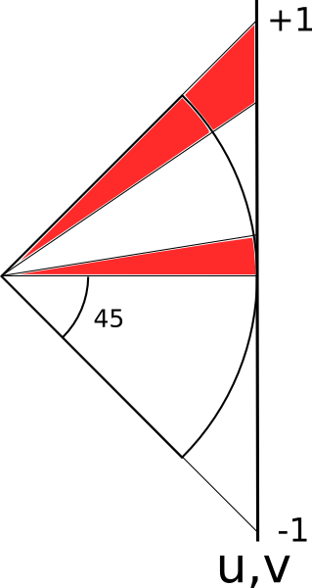
S2 Cell Hierarchy - Construction
Step 2:(x,y,z) => (face,u,v)
Problem: same-area cells on the cube have different sizes on the sphere. Ratio of highest to lowest area: 5.2
Notes:
First non-trivial step: project p to cube face along a radius.
(better view on previous slide)
Call this coordinate system (u,v).
These are names from the library. The functions that compute these coordinate systems are explicit in the library and well commented.
Bottom arc projects to a segment of roughly same size.
Top arc projects to a much longer segment.

Slide 6
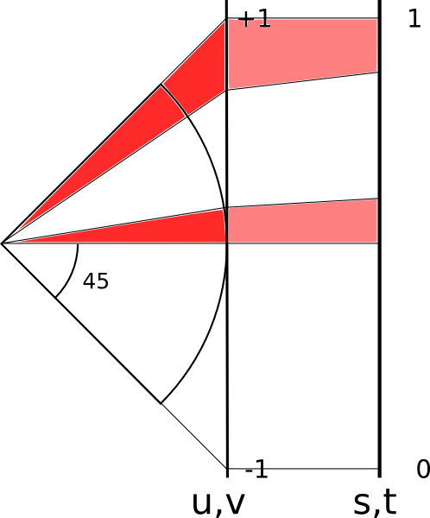
S2 Cell Hierarchy - Construction
Solution: non-linear transform (face,u,v) => (face,s,t)
s,t in [0,1]
Notes:
projection we choose is important

Slide 7
An Aside - Projection Trade-offs
Choices for the (u,v) => (s,t) projection.
Linear: fast, but cell sizes vary widely
Tangent: uses atan() to make sizes more uniform; slow
Quadratic: much faster and almost as good as tangent.
 | Area Ratio | Cell -> Point | Point -> Cell
Linear | 5.20 | 0.087 | 0.085
Tangent | 1.41 | 0.299 | 0.258
Quadratic | 2.08 | 0.096 | 0.108
microseconds
Notes:
default in the library is quadratic, but can be changed easily (compile-time constant)

Slide 8
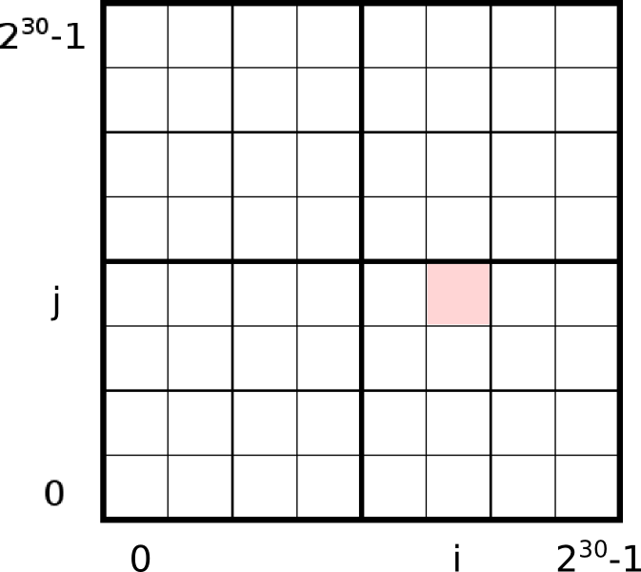
S2 Cell Hierarchy - Construction
Story so far:
(lat,lng)
(x,y,z)
(face,u,v)
(face,s,t)
Discretize (s,t)
(face,i,j)
Quad-tree cell: most significant bits of i and j
one of 6 faces
Notes:
Pink area is a leaf cell, at the bottom of the tree.

Slide 9
S2 Cell Hierarchy - Construction
Last step:
(face,i,j)=> S2CellId
[ID is a 64-bit integer]
Enumerate cells along a Hilbert space-filling curve
fast to encode and decode (bit flipping)
preserves spatial locality
one of 6 faces
Notes:
last step is figuring out a compact representation of a cell.
segue: hilbert curve is naturally hierarchical due to its fractal nature.

Slide 10
S2 Cell Hierarchy - Construction
Last step:
(face,i,j)=> S2CellId
[ID is a 64-bit integer]
Enumerate cells along a Hilbert space-filling curve
fast to encode and decode (bit flipping)
preserves spatial locality
one of 6 faces

Slide 11
S2 Cell Hierarchy - Construction
S2 Cell ID of a leaf cell (level 30):
64 bits
1
face
(in [0,5])
position along the Hilbert curve on the
[0,2³⁰-1] x [0,2³⁰-1] grid (60 bits)
Notes:
last bit is a marker.
cell is leaf iff last bit is 1.

Slide 12
S2 Cell Hierarchy - Construction
S2 Cell ID of a level-2 cell:
64 bits
1
0
0
0
0
0
0
0
0
0
0
0
face
(in [0,5])
position along the Hilbert curve on the
[0,2²-1] x [0,2²-1] grid (4 bits)
Notes:
top of the hierarchy: level 0
there are 6 level-0 cells.
at level 2, we use 4 bits for the hilbert curve position
then 1, then all 0s.

Slide 13
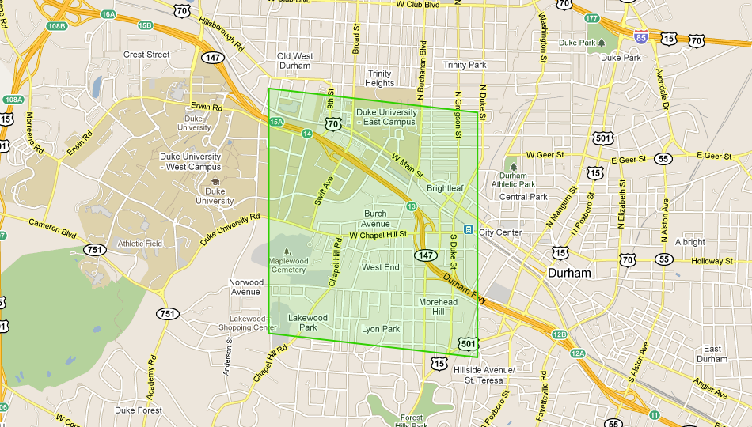
One S2 Cell
Id: 0x89ace41000000000 (0b1000100110101100111001000001000...), Level: 12
Notes:
nice property: s2 cell sides are geodesics.

Slide 14
S2 Cells - Stats
Level | Min Area | Max Area
0 | 85,011,012 km² | 85,011,012 km²
1 | 21,252,753 km² | 21,252,753 km²
12 | 3.31 km² | 6.38 km²
30 | 0.48 cm² | 0.93 cm²
smallest cell
Every cm² on Earth can be represented using a 64-bit integer.

Slide 15
Approximating Regions Using S2 Cells
Given a region, find a (small) set of cells that cover it.
Parameters:
max number of cells
max cell level
min cell level
Max # cells | Median ratio (covering area / region area) | Worst ratio
4 | 3.31 | 15.83
8 | 1.98 | 4.03
20 | 1.42 | 1.94
100 | 1.11 | 1.19
default

Slide 16
What Else Is In the Library
CCW: Given three points on the sphere, are they counter-clockwise?
Multiple implementations, with various tradeoffs.
Polygons
Containment, intersection, union, difference, simplification, centroid computation, etc.
Serialization.
Polygonal lines, Spherical caps.
Extensive tests and micro-benchmarks.

Slide 17
Other Similar Libraries
Hierarchical Triangular Mesh (http://skyserver.org/HTM).The lat/lng <-> triangle id conversion is ~100 slower than the lat/lng <-> s2 cell id conversion.
HEALPix (http://healpix.jpl.nasa.gov). Cell boundaries are not geodesics; structure is more complicated.
COBE Quadrilateralized Spherical Cube (http://lambda.gsfc.nasa.gov/product/cobe/skymap_info_new.cfm). Similar decomposition of sphere. But does not use space-filling curve, edges are not geodesics, and projection is more complicated.

Slide 18
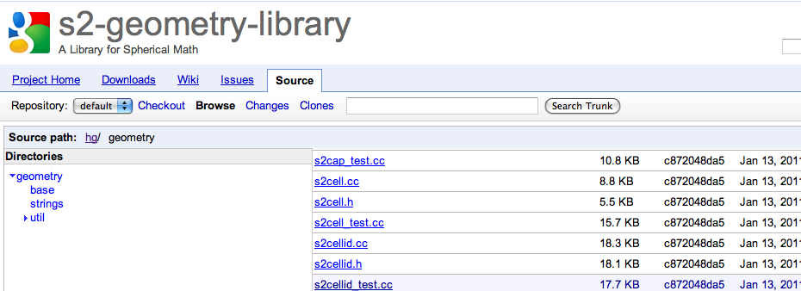
The Code
http://code.google.com/p/s2-geometry-library/

